Slide 1
Transform Products & Services with IoT
Infrastructure Setup

Slide 2
Raspberry Pi 3
1.2GHz 64-bit quad-core ARMv8 CPU
1 GB RAM
802.11n Wireless LAN
Bluetooth 4.1 / Bluetooth Low Energy
4 USB ports
40 GPIO pins
Full HDMI port
Ethernet port
3.5mm audio jack
Camera interface (CSI)
Display interface (DSI)
Micro SD card
VideoCore IV 3D graphics core
$30 US

Slide 3
Sense Hat
The Sense HAT is a sensor board packed with sensors
8x8 RGB LED matrix
five-button joystick
gyroscope
accelerometer
magnetometer
temperature
barometric pressure
humidity
The Sense HAT is the hardware used in the Astro Pi mission on the International Space Station.

Slide 4






Transform Products & Services with IoT
PUBLIC NETWORK
CLOUD NETWORK
BLUEMIX SERVICES
PRIVATE NETWORK
Raspberry Pi with Sense Hat
Browser/Node-Red UI
(Web Client Dashboard)
Node-RED
The purpose of this workshop is to get you started working with Bluemix, Node-Red, Watson IoT, and a Raspberry Pi. You will be defining a Raspberry Pi as an IoT device in the Watson IoT service. Following that, you will use Node-Red to create an application on the Pi that reports sensor information (temperature, humidity, barometric pressure, etc.) to another Node-Red application running on Bluemix.
DashDB
CLOUDANT
NOSQL DB
IoT Platform

Slide 5

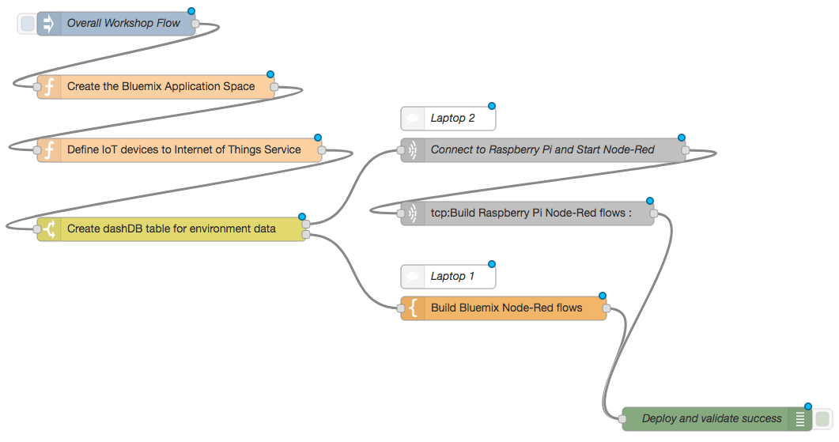
Workshop Flow

Slide 6
Logistics
Work in teams of three, you will. Cooperate, you must.
A number that matches the team number on your badge, each Raspberry Pi has.
Assume responsibility for the Raspberry Pi each evening, the designated team leader will.
Choose your path, you must. If prior experience you have, follow the Jedi Master path. If a more guided approach you require, choose the Jedi Padowan path. Yes, hmmm.
Split development efforts at part iv. To complete part iv use one laptop, to complete part v & vi, another. Hmmmmmm.
Patience you must have, my young padowan. Very agile, the Bluemix UI is.
Questions you have? Slack you should use. #stsa-workshop-faqs

